Slide 1
Capstone 1 –
Non-Technical Presentation
Date: 4/19/2020
Presenter: Rachel Menth

Slide 2
As cap limits continue to increase, there is more money available for players during contract negotiations. Through a statistical analysis, we identified the factors most strongly correlated to a higher salary that players should improve to have a better position during negotiations.
Key Insights
1. Looking at correlations of all statistics shows that 14 that are strongly correlated with salary (highlighted in blue). Almost all strongly correlated stats are related to shooting and scoring.
2. Social media engagement (highlighted in orange) is not strongly correlated to salary but it does have a mild correlation—roughly as impactful as games played or total wins.*
3. Outside of player performance, two other factors were analyzed—age and team—which can also have an impact on salary.
*NOTE: Correlation for social media engagement was calculated after removing outliers while all other correlations included the full data set.

Slide 3
Using the factors that were strongly correlated, we built a model that can predict salary based on performance in those areas, which will be a useful tool for determining how much to ask for in negotiations.
Key Insights
1. The model created is statistically significant and has good explanatory power for salary.
2. A higher number of turnovers were strongly correlated to salary but were left out of the model because we don’t want to encourage players to make more turnovers.
3. Using this model, a player can see how a change in one area, like an increase in free throws attempted, could impact their salary.

Slide 4
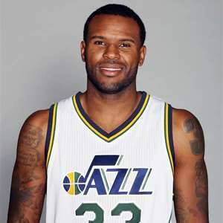
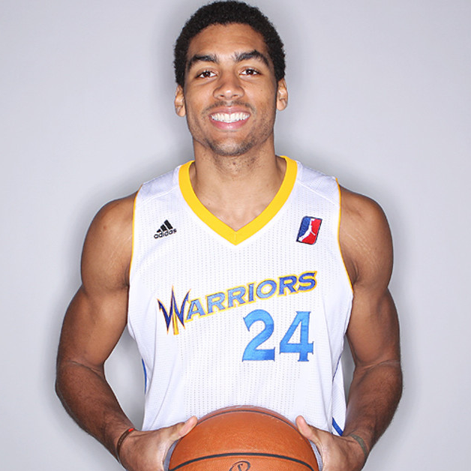
Looking at the model in action shows how modest improvements in player performance could impact salary and reinforces just how important the most strongly correlated factors are to salary.
Trevor Booker
James Michael McAdoo
2016-17 actual salary: $9,250,000
Model estimate: $9,321,034
2016-17 actual salary: $980,431
Model estimate: $903,125
Changes:
+0.8 FG
+1.7 FGA
+1.0 FTA
+ 2.0 Points
+2.3 MPG
Changes:
+0.5 FG
+0.5 FGA
+0.6 TRB
+0.7 Points
+1.2 MPG
New Estimate: $11,328,750
22% increase
New Estimate: $3,654,299
273% increase

Slide 5
Social media engagement is only mildly correlated with salary so we don’t recommend player’s invest their time building a strong Twitter presence. For contract negotiations, time spent improving performance will be much more beneficial.

Slide 6
While age only has a mild correlation to salary, looking at a histogram of age and salary reveals that average salary is lower for younger players before peaking for players between 26-28.
19
21
23
26
28
30
33
35
37
40
42

Slide 7
Outside of player performance, the player’s team can also have an impact on salary. The Eastern conference has a higher overall average salary with more teams paying above average salaries than the Western conference.
Key Insights
1. Overall, 53% of teams pay above average salaries—($6.07 million). In the Eastern conference, 73% of teams pay above average salaries while in the Western conference, only 33% of teams pay above average.
2. Although more teams in the Eastern conference pay above average salaries, the top three average salaries are all at teams in the Western conference: Memphis Grizzlies, Portland Trailblazers, and LA Clippers.

